Slide 1
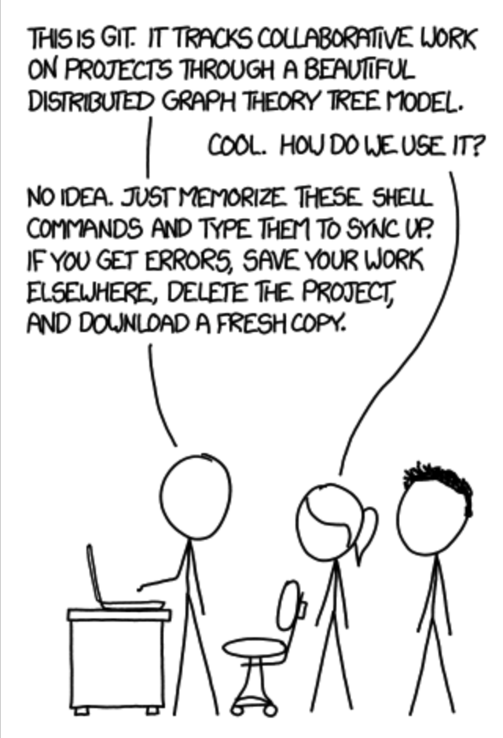


GIT-Developers best friend
&
Welcome to Social Coding

Slide 2

What is GIT
Git is a distributed version control system for tracking changes in source code during software development. It is designed for coordinating work among programers, but it can be used to track changes in any set of files. Its goals include speed, data intigrity and support for distributed, non-linear workflows.
Version Control
1
1,2,3
5,6,7
1,8,9
Start
2nd Jan
22nd March
Release 1
Start
18th August
Release 2
12th Nov
Release 3

Slide 3
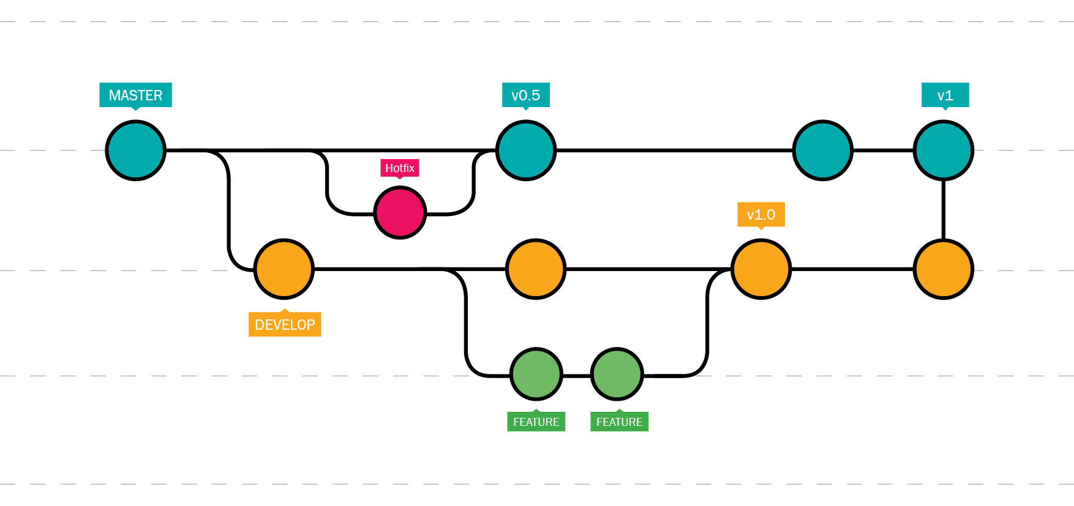
GIT work flow

Slide 4
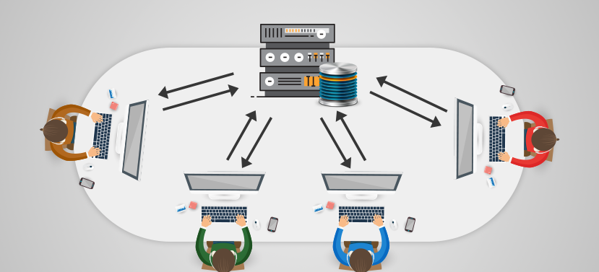

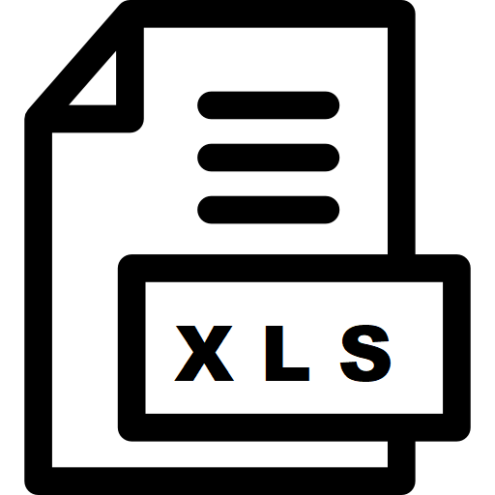


What is GitHub
GitHub is an American company that provides hosting for software development version control using Git. It offers all of the distributed version control and source code management (SCM) functionality of Git as well as adding its own features. It provides access control and several collaboration features such as bug tracking, feature requests, task management, and wikis for every project.
Distributed & Collaborated work
www.GitHub.com

Slide 5
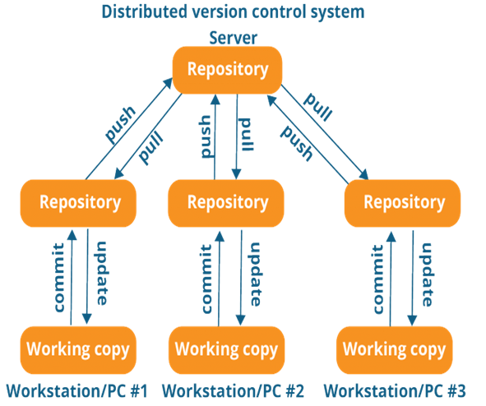
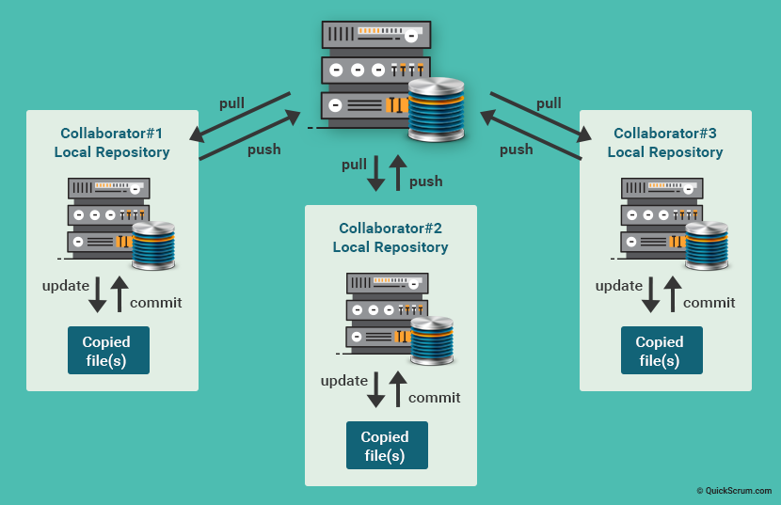
How Git works
Logical representation
Actual physical representation

Slide 6
Advantages of GIT
Version Control: It is a system that records changes to a file or set of files over time so that you can recall specific versions later.
Distributed model: This means your work is your own. You can let others see only what is necessary. Not everything has to be public. There are other advantages to the distributed model, such as the speed (since most everything is local) and possibility of working offline
Branching and merging are easy: Branching is a walk in the park. It feels like a natural part of the workflow. They are cheap (fast and consume very little space) so that you can branch whenever you want. This means you can sandbox your features and ideas till they are ready for the mainstream.
Workflow is flexible: Compared to Centralized VCS, git has the qualities that allow to choose your own workflow. It can be as simple as a centralised workflow to as hierarchical as the dictator-lieutenant workflow. Use the process that best fits you.
Data integrity is assured: Because git uses SHA1 trees, data corruption due to external reasons can be easily detected.

Slide 7






Master: The default development branch. Whenever you create a git repo, a branch named “master” is created which becomes the default active branch.
www.Github.com
master
dev3
dev2
dev1
Hello Repository
Local Repository
Local Repository
Local Repository

Slide 8
Repository: A Git Repository, or a repo, is a folder that you’ve told Git to help you track file changes.
Remote Repository
Local Repository
www.Github.com
Remote Repository
Local Repository
Local Repository
Local Repository

Slide 9
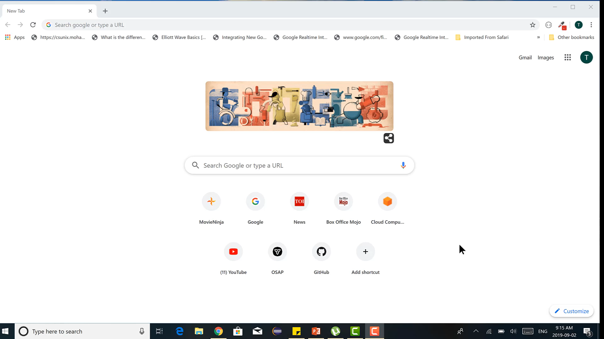
Demo creating a repository

Slide 10
Branch: A branch is an independent line of development. You can think of it as a brand new working directory.
master
master
master
master
master
dev1
dev2
dev3
www.Github.com
master
dev3
dev2
dev1
dev1
Hello Repository
Local Repository
dev2
dev3
Local Repository
Local Repository

Slide 11
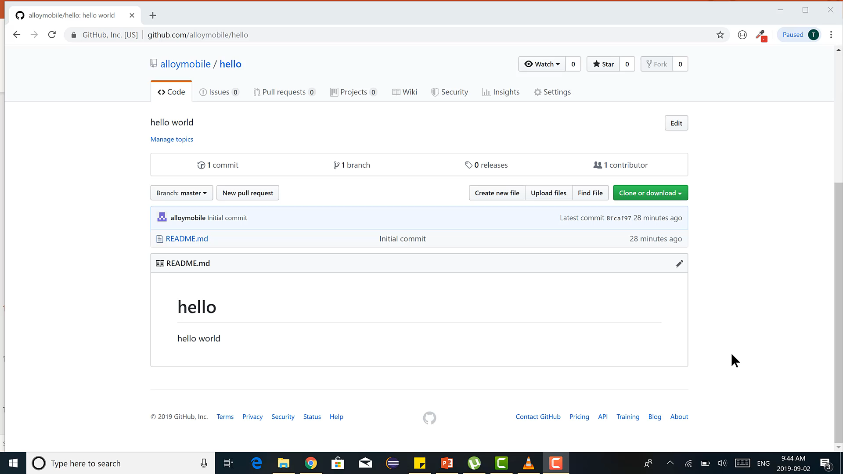
Demo creating a branch

Slide 12

Fork: A fork is a personal copy of another user’s repository that lives on your account.
www.Github.com
master
master
Fork
Hello Repository
Hello Repository
Tapas Account
David Account
Local Repository
Local Repository
Local Repository

Slide 13
Clone: A clone is simply a copy of a repository that lives on your computer instead of on a server.
www.Github.com
Clone
master
master
Remote Repository
Local Repository
Clone
Clone
master
Local Repository
master
Local Repository

Slide 14
Pull: The contents of the remote repository is copied to the local copy of the repository
www.Github.com
master
Remote Repository
A pull command can pull
the master or any branch
to the local computer
Pull
master
master
Local Repository
master

Slide 15
Commit: A commit is a set of one or more changes to a file(or a set of files). Every time you save, it creates a unique ID(“hash”) which helps it keep track of the history.
www.Github.com
master
Remote Repository
master
master
Commit
master
Workspace
Local Repository
master

Slide 16
Push: The contents of the local copy of the repository is copied to the remore repository.
First time the remote repo is cloned afterwards use pull to get the latest changes
www.Github.com
master
master
Clone
or
Pull
Remote Repository
Push
master
master
Commit
A push command sends
the local repository
commit to the remote
branch.
master
Workspace
Local Repository
master

Slide 17
Merge: All the content of one branch is added to the other
master
master
master
master
master
Merge
Merge
Merge
dev1
dev2
dev3

Slide 18
References
https://medium.com/cs-note/git-and-github-for-beginners-iii-tutorial-fb64f7430721
https://codeburst.io/git-and-github-in-a-nutshell-b0a3cc06458f
https://www.quora.com/What-are-the-advantages-and-disadvantages-of-using-Git
https://www.quickscrum.com/Article/ArticleDetails/5181/1/What-is-Git-What-benefits-does-Git-offer
https://www.educba.com/introduction-to-git/
https://guides.github.com/activities/hello-world/

